Slide 1

Introduction to RAG
By Carlo Teufel
Carlo Teufel
Research Assistant
Email: cteufel@ethz.ch
Phone: +41 79 477 6068

Slide 2
Brief History
2018-2020 Foundation Models
GPT-2 , Bert, T5
No instruction-following, limited practical use
2021-2022 Instruction Tuning and Finetuning
GPT-3, InstructGPT, FLAN
Finetuned to follow user instructions and complete specific tasks
Specialized models (e.g., legal, medical, finance)
2022-2023 RAG
Combine LLMs with external knowledge via vector search
Popular for document QA, search, internal knowledge bots

Slide 3
Brief History
2023-2024 Tool Use & Function Calling
LLMs can call APIs, run code, search web, access databases
ReAct, LangChain, OpenAI tools enable multi-modal actions
2024-Present Agentic AI
LLMs as autonomous agents with planning, memory, multi-step reasoning
Frameworks like AutoGen, CrewAI, LangGraph
Personalized assistants, workflow automation, long-context reasoning

Slide 4
Finetuning LLMs
Finetuning: Process of adapting pretrained LLM to perform better on specific task or domain
Involves updating model's weights using a very large amount of labeled, task-specific data
Can significantly improve performance on specific, well-defined problems (Legal Contracts, Biomedical QA etc.) but with downsides:
Requires significant resources
Careful data preparation
Expensive to maintain
Not ideal for document specific tasks (extracting info out of a single PDF)
Is there an easier way?

Slide 5
RAG - ‘Retrieval Augmented Generation’
RAG: Combines the Strengths of LLMs with external data sourcing
Instead of finetuning, RAG adds all relevant information from the documents (or databases/APIs) into the prompt.
Addresses key limitations of LLMs like outdated knowledge and hallucination
Benefits:
No need for finetuning and associated costs (labeling/compute)
Much faster
Allows for flexibility and relevance at runtime.

Slide 6









RAG Overview:
Embedding
1.
Query
Full Pipeline
2.
Chunking
Embedding
Vector Database
3.
Information
Extraction
Relevant Data
4.
LLM(s)
Raw Data
Sources
5.
Data Preparation
Output
Retrieval Augmented Generation

Slide 7



Data Preparation
Information Extraction
Information Extraction
Raw Data
Sources
Text
Tables
Images

Slide 8
Data Preparation
Chunking
Chunking
Break Text down into smaller Chunks by:
Characters
Tokens
Delimiters
Headings
Text
Text Chunks

Slide 9
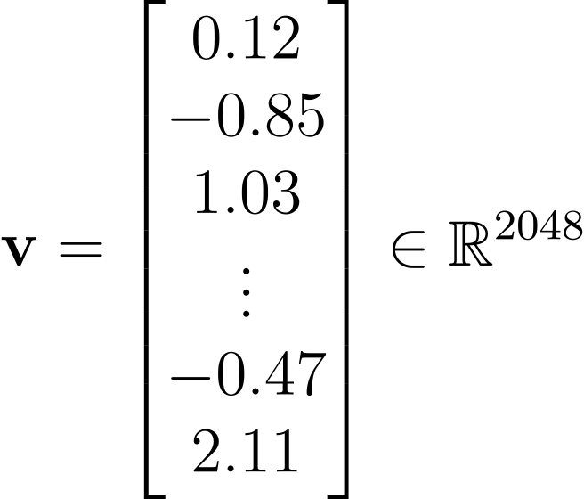
Data Preparation
Embedding
Embedding
Tables
Encodes Tables, Chunks Images into Vectors in same Space
Can be used to compare different blocks with each other
Images
An Embedding Vector could look like this
Text Chunks

Slide 10
Data Preparation
Vector Store
Vector Store
Stores vectors with corresponding content in database
Allows for Efficient Similarity Search (looks for closest neighbors)
Data preparation complete!

Slide 11
RAG Pipeline
Query Embedding
Query
Embedding
Brings query into same space as Data

Slide 12
RAG Pipeline
Retrieval
Vector Store
Finds the k closest vectors to the query vector
Closest in distance means that it is probably closest in meaning and therefore most relevant
Context: Most relevant vectors and their corresponding data

Slide 13
RAG Pipeline
Output Generation
Query
LLM
Query
Example Prompt:
“You are a data extraction expert. Use the following data to answer the question.
DATA:{Data}
QUESTION:{Query} “
The Data, Query are inserted respectively
Output
Data

